Slide 1
TOne new Structure

Slide 2
Main Entities
Suppliers
Sale Zones
Customers
Routing Products
Pricing Products

Slide 3
Supplier Entities
Supplier Zones
Supplier Zone Service
Supplier Codes
Supplier Rates

Slide 4
Sale Zones
Sale Zone Package
Multiple Code Addressing plans

Slide 5
Customers
Sale Zone Package: assigned at creation time and cannot be changed

Slide 6
Routing Products
Provide the customer with voice service at a specific cost and quality
Sale Zone Package: assigned at creation time and cannot be changed
Sale Zones:
All Zones
Selective Zones
Suppliers
All Suppliers
Selective Suppliers

Slide 7
Routing Products
Routing Rules:
Criteria based on Product’s Zones
Rule Settings:
Route Type: Fixed Route or Automatic Route
Percentage Settings
Exclude Options
Order Options

Slide 8
Pricing Products
The purpose of the Pricing product is to define a pricing strategy and assign it to a group of customers
Each customer should be assigned to a single Pricing product at a specific point of time
Sale Zone Package: assigned at creation time and cannot be changed
Routing Product: The default Routing Product used for Cost analysis in order to decide selling rates
Rates: The rates decided on the product

Slide 9
Pricing Products
Pricing Rules
Criteria
Zones
Customers
Rule Settings
Locked Rate
Open Rate with Margin Settings

Slide 10
Routing Rules
Routing Rules can be defined on two levels:
Product Rules: routing rules can be defined on the routing products level
Criteria: Zones (All or Specific within the product)
Rule Settings: Fixed Route or Automatic Route
Exception Rules: generic Routing rules:
Criteria: Customer/Code/Zone
Rule Settings: Fixed Route, Automatic Route, or Block Route

Slide 11
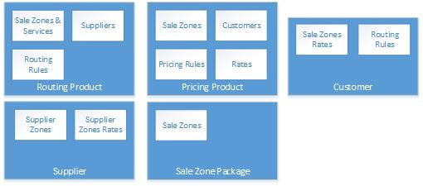

Slide 12
TOne Flow

Slide 13
Supplier Zones
Zone Services
Codes
Rates
Add Suppliers
Import Suppliers Price Lists
Define Routing Product (s)
Build Routes Process
Define Pricing Product (s)
Build Sale Zone Package (s)
Sale Zones
Suppliers
Routing Rules
This will generate routes for the Routing Products
- Define
Sale Zones Services
Pricing Rules
- Do Cost Analysis based on Routes generated from assigned Routing Product
- Do Rate planning and save rates
Sale Zones
Codes

Slide 14
Add Customers
Assign Customers to Pricing Products
Customer Rate Planning
Build Routes Process
This will generate final routes to be sent switch(es)
- The followings are taken from the assigned Pricing product:
Initial Rates
Pricing Rules (locked prices, margin control)
- Do Cost Analysis based on Routes generated from assigned Routing Product

